Slide 1

The Iterated Prisoner's Dilemma and The Evolution of Cooperation EE495 Game Theory and Networked System
Jiaqi Guo JGR9647
Qiulin Li QLA2891
Notes:
This is report for Northwestern university, Social media mining, we are group 4

Slide 2



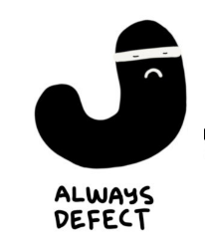
Contents
Iterated Prisoner's Dilemma
Axelrod’s Tournament
Strategy analysis (TIT FOR TAT, GRADUAL …)
The Evolution of Cooperation (2 Special Situations)
Picture referenced from: https://medium.com/thinking-is-hard/a-prisoners-dilemma-cheat-sheet-4d85fe289d87

Slide 3
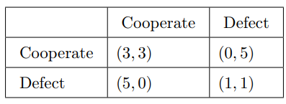


The Prisoner's Dilemma
Prisoner’s dilemma is a strange but fascinating thought experiment / game that can teach us all why some strategies for cooperation are better than others.
Obviously, for such a single-round prisoner’s dilemma game, the Nash equilibrium is (1,1)
Reference: https://en.wikipedia.org/wiki/Prisoner%27s_dilemma
Notes:
The prisoner's dilemma is a hypothetical game set up showing a situation where people won't want to work together even when it's beneficial to do so.
Imagine two people being questioned about the same crime. They’re each talking to the interrogator separately, and the interrogator gives each person the same deal: they can choose to vouch for the other person’s innocence or guilt.
The reason why this problem is tricky is that if you know what the other person is going to do, it’s always to your advantage to say the other person is guilty. BUT since you don’t know what the other person will do, your average reduction will be greater if you cooperate

Slide 4




The Iterated Prisoner's Dilemma
In one-off games, defecting gives a higher payoff, does not matter what other is doing
With multiple games, if the opponent cooperates and defect at random, or follows a set of pattern, always defecting still gives the best payout.
Always defect
Payoff: 22
Start off cooperate then defect
Payoff: 17
Random cooperate and defect
Always cooperate
Payoff: 12
Picture referenced from: https://www.youtube.com/watch?v=BOvAbjfJ0x0
Notes:
The iterated prisoner's dilemma is just like the regular game except you play it multiple times with an opponent and accumulate the scores. In this game, all players have the same goal, which is also to maximize the utility over a repetition of the game.
And…Similar to one off prisoner dilemma game, in multiple games, if the opponent cooperates and defect at random, or follows a set of pattern, always defecting still gives the best payoff. This is because, here, like in a one-off game, defecting has no consequences. This situation will change if the player make decision depending on what the other player did,

Slide 5
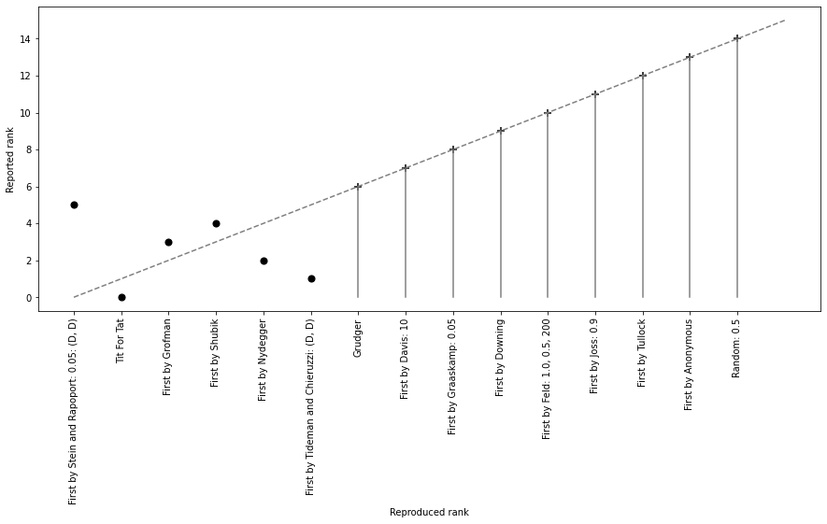
Axelrod’s Tournament
14 strategy submitted + the 50/50 random strategy
Each strategy was paired with each other strategy for 200 iterations of a Prisoner's Dilemma game
Scored is the total points accumulated through the tournament.
Our reproduced results versus the reported ones
Reference: https://doi.org/10.1177/002200278002400101
Notes:
In the 1980s, professor of Robert Axelrod ran a tournament inviting strategies from collaborators all over the world for the Iterated Prisoner’s Dilemma. The winner was a strategy called TIT for TAT, and the figure at the left illustrate the rank of the total points. We have reproduced this tournament and get similar result. The difference of the first 6 strategies may caused by the insufficient repetitions of Axelrod’s works.
In today’s presentation, we will start from the winner of this tournament，TIT for TAT. Because many recent strategies are actually the variant of it.

Slide 6

TIT FOR TAT
Cooperates on the first round and then just copies what the other person did last round
Since it can reciprocate quickly against defectors. Any strategy against it would get instantly punishment and put into a bad situation (get lower payoff)
TIT FOR TAT
3 | 0 | 1 | 5 | 3 | 12
CO | CO | DE | DE | CO
CO | DE | DE | CO | CO
3 | 5 | 1 | 0 | 3 | 12
Opponent
Retaliating: it punishes defection, which prevent some losses and disincentive an opponent from defecting
The only way to maximize payoff is start off cooperating and never defect
Notes:
TIT FOR TAT is a very simple but effective strategy, it cooperates in the first round and then just copies what the other player did in the previous round, so it can respond quickly to any defection. This means that any strategy against it will be punished immediately and get into a bad situation. For example, if an opponent defects at the second round (as shown in the figure below), he will get punished immediately, causing the payoff to drop in the next round. Even if he tries to go back to cooperating, he will gain less than keeping cooperate with TIT FOR TAT for whole rounds. So, TIT FOR TAT is a kind of retaliating strategy that punishes defecting and disincentive an opponent from defecting.

Slide 7

Problem of TIT FOR TAT
Because of the copying nature of TIT FOR TAT, it can not ever beat an opponent.
TIT FOR TAT
3 | 0 | 1 | 5 | 3 | 12
CO | CO | DE | DE | CO
CO | DE | DE | CO | CO
3 | 5 | 1 | 0 | 3 | 12
Tie Situation
Defect at the middle of game
TIT FOR TAT
3 | 3 | 3 | 3 | 0 | 12
CO | CO | CO | CO | CO
CO | CO | CO | CO | DE
3 | 3 | 3 | 3 | 5 | 17
Loss Situation
Defect at the end of the game
Oppositely，Always defect can only win or tie, but the payoff is lower (bad)
Notes:
One major feature of TIT for TAT is, Because of the copying nature of TIT FOR TAT, it can not ever beat an opponent. It can either tie or lose, depends on which round its opponent defects. The opposite is always defect, it can only tie or win if the opponent want to cooperate. Here, we want to compared it with other strategies which called GRADUAL

Slide 8
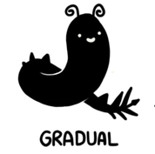
GRADUAL
Never the first to defect, but when the other side does, it never cooperate again
Compared with GRADUAL, TIT FOR TAT allows cooperation if the person wants to cooperate again
GRADUAL
3 | 0 | 1 | 5 | 5 | 14
CO | CO | DE | DE | DE
CO | DE | DE | CO | CO
3 | 5 | 1 | 0 | 0 | 9
Opponent defects at round 2
The punishment GRUDGER gives, hurts the punisher alongside the punish.
Notes:
Gradual is never the first to defect, but once the other defected, it never cooperate again, Compared with GRADUAL, TIT FOR TAT allows cooperation if the person wants to cooperate again so that both TIT FOR TAT and his opponent can cooperate forwards. So, that's why TIT FOR TAT wins this tournament, it is nice, it is retaliatory, it prevents defections, and it is forgiving.

Slide 9

TIT for TWO TATS
Require two defections before it retaliate
When play with strategy like Joss, echo effect may occur.
It prevents the echo effects that hurt regular TIT for TATs.
TIT FOR TWO TATs
3 | 0 | 3 | 3 | 3 | 14
CO | CO | CO | CO | CO
CO | DE | CO | CO | CO
3 | 5 | 3 | 3 | 3 | 9
Opponent defects at round 2
Tester: starts out cooperating but tries defecting to see how opponent react. If the opponent punishes, it cooperates to apologize, and never defect again.
3 | 0 | 3 | 0 | 3 | 9
CO | CO | CO | CO | CO
CO | DE | CO | DE | CO
3 | 5 | 3 | 5 | 3 | 19
TIT FOR TWO TATs
Over Forgiving
TESTER
Notes:
TIT for two TATs increase the rounds of defection before it retaliate. Which can prevent the echo effects that hurt regular TIT for TATs. But when facing with strategies like tester who starts out cooperating at first but tries defecting to see how the opponent react. TIT for two TATs may become too forgiving.
So far, we see, most strategies trying to improve the tit for tat strategy, by let it to be less nice and trying to find a way to capitalize on defection, some stratege instead avoid punishing every defection, and ended up being better in the long run.
In the next section we will reconsider this tournament from a more evolutionary perspective and place the Prisoner’s Dilemma problem into a more dynamic model. To see how cooperation can emerge in a world of self-seeking egoists.

Slide 10
The Evolution of Cooperation

Slide 11
Moran Process (Evolution of Cooperation)
The Moran process is a common population model of natural selection, which works as follows. Given an initial population of players, the population is iterated in rounds consisting of:
1. matches played between each pair of players, with the cumulative total scores recorded
2. a player is chosen to reproduce proportional to the player’s score in the round
3. a player is chosen at random to be replaced
TIT FOR TAT
Always
Defector
Always
Defector
Cooperator
TIT FOR TAT
TIT FOR TAT
Cooperator
Random
Always
Defector
Cooperator
Reference:
[1] https://en.wikipedia.org/wiki/Moran_process
[2] Moran, P. (1958). Random processes in genetics. Mathematical Proceedings of the Cambridge Philosophical Society, 54(1), 60-71. doi:10.1017/S0305004100033193
Notes:
After learning the strategies for Iterated Prisoner’s Dilemma, we applied them to the evolution of cooperation. More specificly, we simulated the moran process in a reproduction situation with the mentioned strategies and had some interesting findings.
[ppt]
In our simulation, the score of a single match is the payoff of each strategy. It is positively correlated with the possibility to be chosen to reproduce. For strategies with higher payoff like TIT for TAT, it will reproduce more of them into the next generation. For strategies with lower payoff like Random, we will put fewer of them into the next generation. Let’s first consider a population of 9 players, which consist 3 TIT for TATs, 3 Always Defectors, 3 Cooperators and 1 random.

Slide 12
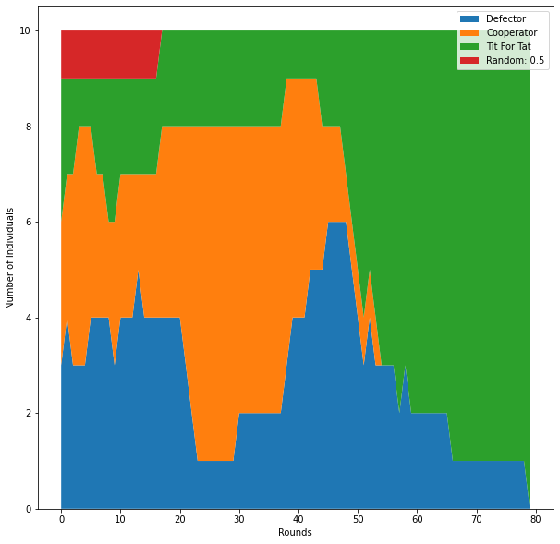
Example 1: A MIXED POPULATION
TIT FOR TAT
Always
Defector
Cooperator
TIT FOR TAT
TIT FOR TAT
Always
Defector
Cooperator
Always
Defector
Random
Cooperator
1. When all 4 types of individuals exist:
Payoff: Defector > TIT For TAT > Random > Cooperator
2. When Random are eliminated at round 20
Payoff: Defector > TIT For TAT > Cooperator
3. When Cooperators are eliminated at round 55
Payoff: TIT For TAT > Defector
4. Only TIT For TAT survive.
Notes:
Through the simulation of Moran process, we can see the changing process of four populations from the figure on the right.
The Defector, did well at the start, but as its victim, Cooperator went extinct, its population declined as well. The real successful strategies were ones that could work well with other successful strategies, basically, they are those nice or otherwise cooperative strategies. They support one another and were able to continue to reproduce.

Slide 13
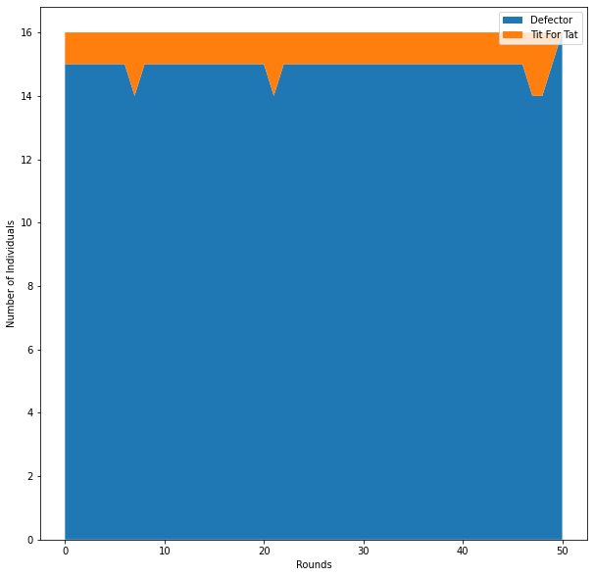
Example 2: DEFECTOR WORLD I
TIT FOR TAT
Always
Defector
Always
Defector
Always
Defector
Always
Defector
Always
Defector
Always
Defector
Always
Defector
Always
Defector
Always
Defector
Always
Defector
Always
Defector
Always
Defector
Always
Defector
Always
Defector
Always
Defector
Always
Defector
Can single TIT For TAT invade a group of always defectors?
The result is No, because TIT FOR TAT will have nobody to cooperate with and just comes away as the worst reproducer
TIT FOR TAT
0 | 1 | 1 | 1 | 1 | 4
CO | DE | DE | DE | DE
DE | DE | DE | DE | DE
5 | 1 | 1 | 1 | 1 | 9
Always
Defector
Notes:
Let’s consider another situation, it is a world of always defectors, it is a cruel world. Can a nice mutation establish itself? Can something like TIT For TAT invade a group of always defectors? Unfortunately, the result is No, because a single TIT For TAT can not find anybody in population to cooperate with, and always come away as the worst reproducer. However we can improve the situation by adding an extra TIT FOR TAT.

Slide 14
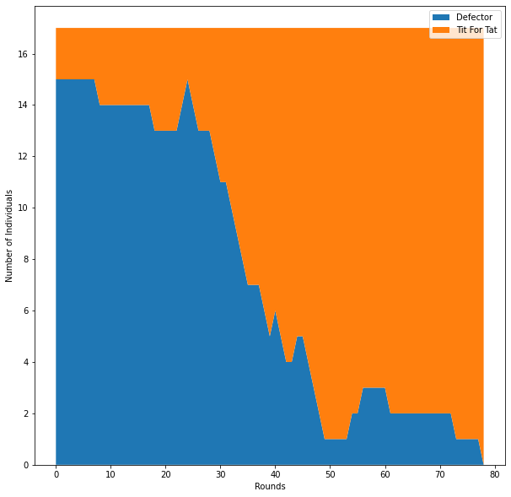
Example 2: DEFECTOR WORLD II
TIT FOR TAT
Always
Defector
Always
Defector
Always
Defector
Always
Defector
Always
Defector
Always
Defector
Always
Defector
TIT FOR TAT
Always
Defector
Always
Defector
Always
Defector
Always
Defector
Always
Defector
Always
Defector
Always
Defector
Always
Defector
If there are a couple TIT FOR TATs, then they could gain more from one another than they loss to the defector in the tournaments.
TIT FOR TAT
3 | 3 | 3 | 3 | 3 | 15
CO | CO | CO | CO | CO
CO | CO | CO | CO | CO
3 | 3 | 3 | 3 | 3 | 15
Always
Defector
1 | 1 | 1 | 1 | 1 | 5
DE | DE | DE | DE | DE
DE | DE | DE | DE | DE
1 | 1 | 1 | 1 | 1 | 5
>
TIT FOR TAT
Always
Defector
Notes:
If there are a couple TIT FOR TATs, then they could gain more from one another than they loss to the defector. So, everything become different. And eventually they would end up taking over and once established, it would be really hard for a non-nice strategy to invade TIT FOR TAT, because TIT FOR TAT has the properties of retaliating. Those non-nice strategy will get lower payoff when playing game with TIT FOR TAT, and become the worst reproducer.
TIT for TAT does quite well in these model reproduction situations, it can invade other strategies, and it is difficult to be invaded. But in a larger reproduction game, it has no foresight and almost no memory. Instead, it just reacts to specific situations.

Slide 15
Thank you for your listening!
Referenced:
[1] Axelrod, Robert, and William D. Hamilton. "The evolution of cooperation." science 211.4489 (1981): 1390-1396.
[2] Moran, P. (1958). Random processes in genetics. Mathematical Proceedings of the Cambridge Philosophical Society, 54(1), 60-71. doi:10.1017/S0305004100033193

